Slide 1
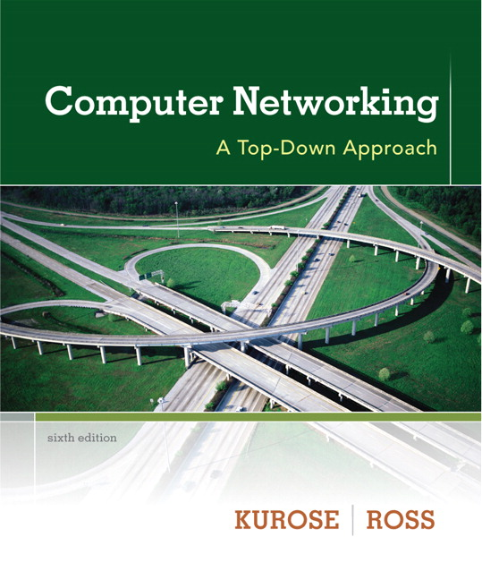
Chapter 4 & 5
Network Layer
(Sec – 4.1, 4.3, & 5.2)
Instructor: Mohammad Mamun Elahi
Office: 5th Floor (Room # 522)
Email: mmelahi@cse.uiu.ac.bd
Class Location: http://meet.google.com/rca-cwkd-cmh
Lectures: S W 12:10 pm (Sec A), 2-00 pm (Sec C)
Notes derived from “Computer Networking: A Top Down Approach”, Jim Kurose, Keith Ross, Addison-Wesley.
Slides are adapted from the companion web site of the book, as modified by A.K.M. Muzahidul Islam.
Computer Networking: A Top Down Approach
7th edition
Jim Kurose, Keith Ross
Addison-Wesley
March 2017

Slide 2
















Network-layer services and protocols
transport segment from sending to receiving host
  sender: encapsulates segments into datagrams, passes to link layer
  receiver: delivers segments to transport layer protocol
network layer protocols in every Internet device: hosts, routers
routers:
  examines header fields in all IP datagrams passing through it
  moves datagrams from input ports to output ports to transfer datagrams along end-end path
mobile network
national or global ISP
application
transport
network
link
physical
network
link
physical
network
link
physical
network
link
physical
network
link
physical
network
link
physical
datacenter
network
application
transport
network
link
physical
enterprise
network

Slide 3


Two key network-layer functions
network-layer functions:
forwarding: move packets from a router’s input link to appropriate router output link
analogy: taking a trip
forwarding: process of getting through single interchange
routing: process of planning trip from source to destination
routing: determine route taken by packets from source to destination
  routing algorithms
forwarding
routing

Slide 4
Network layer: data plane, control plane
The network layer can be decomposed into two interacting parts:
The data plane and the control plane.
Data plane:
local, per-router function
Determines how datagram arriving on router input port is forwarded to router output port.
Control plane
network-wide logic
Determines how datagram is routed among routers along end-end path from source host to destination host
Two control-plane approaches:
  traditional routing algorithms: implemented in routers
  software-defined networking (SDN): implemented in (remote) servers
values in arriving
packet header
0111
1
3
2

Slide 5
Input port functions
lookup,
forwarding
queueing
line
termination
link
layer
protocol
(receive)
switch
fabric
physical layer:
bit-level reception
decentralized switching:
using header field values, lookup output port using forwarding table in input port memory (“match plus action”)
destination-based forwarding: forward based only on destination IP address (traditional)
generalized forwarding: forward based on any set of header field values
link layer:
e.g., Ethernet
(chapter 6)

Slide 6
Network Layer: Internet
The Internet Control Message Protocol (ICMP) is a network layer protocol used by network devices to diagnose network communication issues.
Used to determine whether or not data is reaching its intended destination in a timely manner.
Used on network devices, such as routers.
Crucial for error reporting and testing, but it can also be used in distributed denial-of-service (DDoS) attacks.
host, router network layer functions:
transport layer: TCP, UDP
IP protocol
datagram format
addressing
packet handling conventions
Path-selection algorithms: implemented in
routing protocols (OSPF, BGP)
SDN controller
network
layer
forwarding
table
ICMP protocol
used by network devices
error reporting
router “signaling”
link layer
physical layer

Slide 7
IP Datagram format
32 bits
IP protocol version number
head.
len
type of
service
total datagram
length (bytes)
ver
length
header length(bytes)
“type” of service:
diffserv (0:5)
ECN (6:7)
flgs
fragment
offset
fragmentation/
reassembly
16-bit identifier
time to
live
upper
layer
header
checksum
header checksum
TTL: remaining max hops
(decremented at each router)
source IP address
32-bit source IP address
destination IP address
Maximum length: 64K bytes
Typically: 1500 bytes or less
upper layer protocol (e.g., TCP or UDP)
32-bit destination IP address
overhead
options (if any)
e.g., timestamp, record route taken
20 bytes of TCP
20 bytes of IP
= 40 bytes + app layer overhead for TCP+IP
payload data
(variable length,
typically a TCP
or UDP segment)

Slide 8
DHCP: Dynamic Host Configuration Protocol
Obtaining a Host Address: The Dynamic Host Configuration Protocol Once an organization has obtained a block of addresses, it can assign individual IP addresses to the host and router interfaces in its organization.
A system administrator will typically manually configure the IP addresses into the router (often remotely, with a network management tool). Host addresses can also be configured manually, but typically this is done using the Dynamic Host Configuration Protocol (DHCP) [RFC 2131].
DHCP allows a host to obtain (be allocated) an IP address automatically. A network administrator can configure DHCP so that a given host receives the same IP address each time it connects to the network, or a host may be assigned a temporary IP address that will be different each time the host connects to the network.
In addition to host IP address assignment, DHCP also allows a host to learn additional information, such as its subnet mask, the address of its first-hop router (often called the default gateway), and the address of its local DNS server.

Slide 9
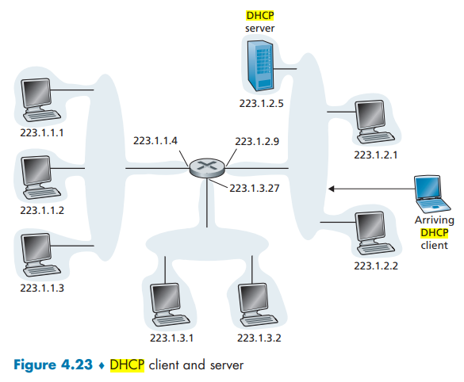
DHCP is a client-server protocol. A client is typically a newly arriving host wanting to obtain network configuration information, including an IP address for itself.
In the simplest case, each subnet (in the addressing sense of Figure 4.20) will have a DHCP server. If no server is present on the subnet, a DHCP relay agent (typically a router) that knows the address of a DHCP server for that network is needed.
Figure 4.23 shows a DHCP server attached to subnet 223.1.2/24, with the router serving as the relay agent for arriving clients attached to subnets 223.1.1/24 and 223.1.3/24.
In our discussion below, we’ll assume that a DHCP server is available on the subnet.

Slide 10
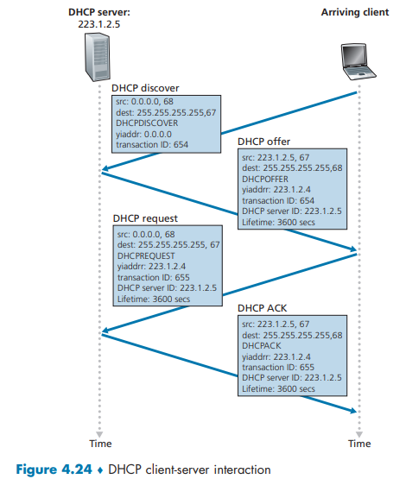
For a newly arriving host, the DHCP protocol is a four-step process.
yiaddr (as in “your Internet address”): the address being allocated to the newly arriving client.
Step 1: DHCP server discovery.
  A newly arriving host is to find a DHCP server with which to interact using a DHCP discover message
  A client sends within a UDP packet to port 67. The UDP packet is encapsulated in an IP datagram.
  But to whom should this datagram be sent?
    DHCP discover message along with the broadcast destination IP address of 255.255.255.255 and a “this host” source IP address of 0.0.0.0.
Step 2: DHCP server offer(s).
  A DHCP server receiving a DHCP discover message responds to the client with a DHCP offer message using the IP broadcast address of 255.255.255.255.
  Why this server reply must also be broadcast ?
    Since several DHCP servers can be present on the subnet.
Step 3: DHCP request.
  The newly arriving client will choose from among one or more server offers and
  Respond to its selected offer with a DHCP request message, echoing back the configuration parameters.
Step 4: DHCP ACK.
  The server responds to the DHCP request message with a DHCP ACK message, confirming the requested parameters.

Slide 11

NAT: network address translation
NAT: all devices in local network share just one IPv4 address as far as outside world is concerned
rest of
Internet
local network (e.g., home network) 10.0.0/24
10.0.0.1
138.76.29.7
10.0.0.4
10.0.0.2
10.0.0.3
all datagrams leaving local network have same source NAT IP address: 138.76.29.7, but different source port numbers
datagrams with source or destination in this network have 10.0.0/24 address for source, destination (as usual)

Slide 12
NAT: network address translation
  all devices in local network have 32-bit addresses in a “private” IP address space (10/8, 172.16/12, 192.168/16 prefixes) that can only be used in local network
  advantages:
    just one IP address needed from provider ISP for all devices
    can change addresses of host in local network without notifying outside world
    can change ISP without changing addresses of devices in local network
    security: devices inside local net not directly addressable, visible by outside world

Slide 13
NAT: network address translation
implementation: NAT router must (transparently):
  outgoing datagrams: replace (source IP address, port #) of every outgoing datagram to (NAT IP address, new port #)
      remote clients/servers will respond using (NAT IP address, new port #) as destination address
  remember (in NAT translation table) every (source IP address, port #) to (NAT IP address, new port #) translation pair
  incoming datagrams: replace (NAT IP address, new port #) in destination fields of every incoming datagram with corresponding (source IP address, port #) stored in NAT table

Slide 14
NAT: network address translation
NAT translation table
WAN side addr LAN side addr
2: NAT router changes datagram source address from 10.0.0.1, 3345 to 138.76.29.7, 5001,
updates table
1: host 10.0.0.1 sends datagram to 128.119.40.186, 80
138.76.29.7, 5001 10.0.0.1, 3345
…… ……
S: 10.0.0.1, 3345
D: 128.119.40.186, 80
10.0.0.1
1
2
S: 138.76.29.7, 5001
D: 128.119.40.186, 80
10.0.0.4
10.0.0.2
138.76.29.7
S: 128.119.40.186, 80
D: 10.0.0.1, 3345
4
S: 128.119.40.186, 80
D: 138.76.29.7, 5001
3
10.0.0.3
3: reply arrives, destination address: 138.76.29.7, 5001

Slide 15
NAT: network address translation
NAT translation table
WAN side addr LAN side addr
198.15.25.5, 7001 192.168.0.1, 4001
…… ……
S:
D:
1
10.0.0.1
2
S: 138.76.29.7, 5001
D: 128.119.40.186, 80
10.0.0.4
10.0.0.2
138.76.29.7
S: 128.119.40.186, 80
D: 138.76.29.7, 5001
3
10.0.0.3
S:
D:
4

Slide 16
NAT: network address translation
NAT has been controversial:
  routers “should” only process up to layer 3
  address “shortage” should be solved by IPv6
  violates end-to-end argument (port # manipulation by network-layer device)
  NAT traversal: what if client wants to connect to server behind NAT?
but NAT is here to stay:
  extensively used in home and institutional nets, 4G/5G cellular nets

Slide 17
IP fragmentation/reassembly
network links have MTU (max. transfer size) - largest possible link-level frame
  different link types, different MTUs
large IP datagram divided (“fragmented”) within net
  one datagram becomes several datagrams
  “reassembled” only at destination
  IP header bits used to identify, order related fragments
…
fragmentation:
in: one large datagram
out: 3 smaller datagrams
reassembly
…

Slide 18
IP fragmentation/reassembly
example:
4000 byte datagram
MTU = 1500 bytes
length
=4000
ID
=x
fragflag
=0
offset
=0
one large datagram becomes
several smaller datagrams
1480 bytes in
data field + HLEN 20 bytes
length
=1500
ID
=x
fragflag
=1
offset
=0
offset =
1480/8
length
=1500
ID
=x
fragflag
=1
offset
=185
length
=1040
ID
=x
fragflag
=0
offset
=370

Slide 19
The Fragment Offset
The Fragment Offset field (13 bits) is used to indicate the starting position of the data in the fragment in relation to the start of the data in the original packet.
This information is used to reassemble the data from all the fragments (whether they arrive in order or not).
In the first fragment the offset is 0 as the data in this packet starts in the same place as the data in the original packet (at the beginning).
In subsequent fragments, the value is the offset of the data the fragment contains from the beginning of the data in the first fragment (offset 0), in 8 byte ‘blocks’ (aka octawords).
Example:
  If a packet containing 800 bytes of data is split into two equal fragments carrying 400 bytes of data, the fragment offset of the first fragment is 0, of the second fragment 50 (400/8).
  The offset value must be the number of 8 byte blocks of data, which means the data in the prior fragment must be a multiple of 8 bytes.
  The last fragment can carry data that isn’t a multiple of 8 bytes as there won’t be a further fragment with an offset that must meet the 8 byte ‘rule’.

Slide 20
Example 2
An IP router with a Maximum Transmission Unit (MTU) of 1500 bytes has received an IP packet of size 4404 bytes with an IP header of length 20 bytes. The values of the relevant fields in the header of the third IP fragment generated by the router for this packet are
(A) Datagram Length: 1444
  Number of packet fragments = ⌈ (total size of packet)/(MTU) ⌉ = ⌈ 4404/1500 ⌉ = ⌈ 2.936 ⌉ = 3
    So Datagram with data 4404 byte fragmented into 3 fragments.
  The first frame carries bytes 0 to 1479 (because MTU is 1500 bytes and HLEN is 20 byte so the total bytes in fragments is maximum 1500-20=1480).
  The second fragment carries byte 1480 to 2959.
  The third fragment carries byte 2960 to 4404.

Slide 21
IPv6 Packets
Limitations of IPv4
IPv4 has three major limitations:
  IPv4 address depletion – We have basically run out of IPv4 addressing.
  Lack of end-to-end connectivity – To make IPv4 survive this long, private addressing and NAT were created. This ended direct communications with public addressing.
  Increased network complexity – NAT was meant as temporary solution and creates issues on the network as a side effect of manipulating the network headers addressing. NAT causes latency and troubleshooting issues.
Notes:
8 – Network Layer
8.3 – IPv6 Packets
8.3.1 – Limitations of IPv4

Slide 22
IPv6: motivation
initial motivation: 32-bit IPv4 address space would be completely allocated
additional motivation:
  speed processing/forwarding: 40-byte fixed length header
  enable different network-layer treatment of “flows”

Slide 23
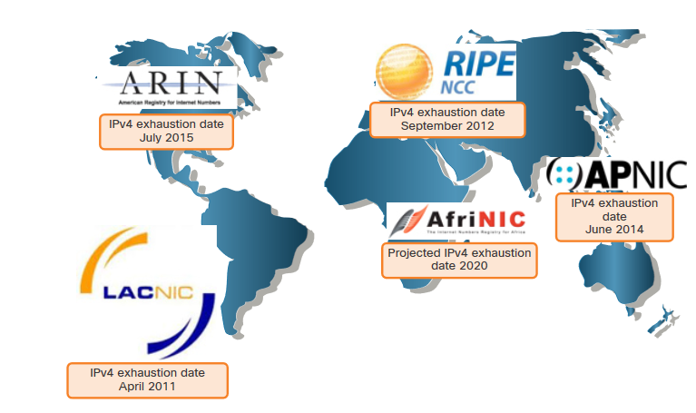
IPv4 Issues
Need for IPv6
IPv4 is running out of addresses. IPv6 is the successor to IPv4. IPv6 has a much larger 128-bit address space.
The development of IPv6 also included fixes for IPv4 limitations and other enhancements.
With an increasing internet population, a limited IPv4 address space, issues with NAT and the IoT, the time has come to begin the transition to IPv6.
Notes:
12 – IPv6 Addressing
12.1 – IPv4 Issues
12.1.1 – Need for IPv6

Slide 24
IPv6 datagram format
flow label: identify datagrams in same "flow.” (concept of “flow” not well defined).
32 bits
priority: identify priority among datagrams in flow
ver
pri
flow label
payload len
next hdr
hop limit
source address
(128 bits)
128-bit
IPv6 addresses
destination address
(128 bits)
payload (data)
What’s missing (compared with IPv4):
no checksum (to speed processing at routers)
no fragmentation/reassembly
no options (available as upper-layer, next-header protocol at router)

Slide 25
IPv6 Packets
IPv6 Packet Header
Significant fields in the IPv6 header:
Function | Description
Version | This will be for v6, as opposed to v4, a 4 bit field= 0110
Traffic Class | Used for QoS: Equivalent to DiffServ – DS field
Flow Label | Informs device to handle identical flow labels the same way, 20 bit field
Payload Length | This 16-bit field indicates the length of the data portion or payload of the IPv6 packet
Next Header | I.D.s next level protocol: ICMP, TCP, UDP, etc.
Hop Limit | Replaces TTL field Layer 3 hop count
Source IPv4 Address | 128 bit source address
Destination IPV4 Address | 128 bit destination address
Notes:
8 – Network Layer
8.3 – IPv6 Packets
8.3.4 – IPv6 Packet Header

Slide 26
IPv6 Address Representation
IPv6 Addressing Formats
IPv6 addresses are 128 bits in length and written in hexadecimal.
IPv6 addresses are not case-sensitive and can be written in either lowercase or uppercase.
The preferred format for writing an IPv6 address is x:x:x:x:x:x:x:x, with each “x” consisting of four hexadecimal values.
In IPv6, a hextet is the unofficial term used to refer to a segment of 16 bits, or four hexadecimal values.
Examples of IPv6 addresses in the preferred format:
        2001:0db8:0000:1111:0000:0000:0000:0200
        2001:0db8:0000:00a3:abcd:0000:0000:1234
Notes:
12 – IPv6 Addressing
12.2 – IPv6 Address Representation
12.2.1 – IPv6 Addressing Formats

Slide 27
IPv6 Address Representation
Rule 1 – Omit Leading Zero
The first rule to help reduce the notation of IPv6 addresses is to omit any leading 0s (zeros).
  Examples:
01ab can be represented as 1ab
09f0 can be represented as 9f0
0a00 can be represented as a00
00ab can be represented as ab
Note: This rule only applies to leading 0s, NOT to trailing 0s, otherwise the address would be ambiguous.
Type | Format
Preferred | 2001 : 0db8 : 0000 : 1111 : 0000 : 0000 : 0000 : 0200
No leading zeros | 2001 : db8 : 0 : 1111 : 0 : 0 : 0 : 200
Notes:
12 – IPv6 Addressing
12.2 – IPv6 Address Representation
12.2.2 – Omit Leading Zero

Slide 28
IPv6 Address Representation
Rule 2 – Double Colon
A double colon (::) can replace any single, contiguous string of one or more 16-bit hextets consisting of all zeros.
Example:
2001:db8:cafe:1:0:0:0:1 (leading 0s omitted) could be represented as 2001:db8:cafe:1::1
Note: The double colon (::) can only be used once within an address, otherwise there would be more than one possible resulting address.
Type | Format
Preferred | 2001 : 0db8 : 0000 : 1111 : 0000 : 0000 : 0000 : 0200
Compressed | 2001:db8:0:1111::200
Notes:
12 – IPv6 Addressing
12.2 – IPv6 Address Representation
12.2.2 – Rule 2 – Double Colon
12.2.4 – Activity – IPv6 Address Representation

Slide 29
IPv4 Issues
IPv4 and IPv6 Coexistence
Both IPv4 and IPv6 will coexist in the near future and the transition will take several years.
The IETF has created various protocols and tools to help network administrators migrate their networks to IPv6. These migration techniques can be divided into three categories:
  Dual stack -The devices run both IPv4 and IPv6 protocol stacks simultaneously.
  Tunneling – A method of transporting an IPv6 packet over an IPv4 network. The IPv6 packet is encapsulated inside an IPv4 packet.
  Translation - Network Address Translation 64 (NAT64) allows IPv6-enabled devices to communicate with IPv4-enabled devices using a translation technique similar to NAT for IPv4.
Notes:
12 – IPv6 Addressing
12.1 – IPv4 Issues
12.1.2 – IPv4 and IPv6 Coexistence
12.1.3 – Check Your Understanding – IPv4 Issues

Slide 30
Transition from IPv4 to IPv6
not all routers can be upgraded simultaneously
  no “flag days”
  how will network operate with mixed IPv4 and IPv6 routers?
tunneling: IPv6 datagram carried as payload in IPv4 datagram among IPv4 routers (“packet within a packet”)
  tunneling used extensively in other contexts (4G/5G)
IPv4 header fields
IPv6 header fields
IPv4 payload
IPv4 source, dest addr
IPv6 source dest addr
UDP/TCP payload
IPv6 datagram
IPv4 datagram

Slide 31
Tunneling
A
B
IPv4 tunnel
connecting IPv6 routers
E
F
logical view:
IPv6
IPv6/v4
IPv6/v4
IPv6
A
B
C
D
E
F
physical view:
IPv6
IPv6/v4
IPv4
IPv4
IPv6/v4
IPv6
flow: X
src: A
dest: F
data
src:B
dest: E
src:B
dest: E
src:B
dest: E
flow: X
src: A
dest: F
data
Flow: X
Src: A
Dest: F
data
Flow: X
Src: A
Dest: F
data
Flow: X
Src: A
Dest: F
data
Note source and destination addresses!
A-to-B:
IPv6
B-to-C:
IPv6 inside
IPv4
B-to-C:
IPv6 inside
IPv4
B-to-C:
IPv6 inside
IPv4
E-to-F:
IPv6

Slide 32
Tunneling – Cont’d
Suppose two IPv6 nodes (in this example, B and E in Figure 4.27) want to interoperate using IPv6 datagrams but are connected to each other by intervening IPv4 routers.
The intervening set of IPv4 routers between two IPv6 routers referred as a tunnel.
With tunneling, the IPv6 node on the sending side of the tunnel (in this example, B) takes the entire IPv6 datagram and puts it in the data (payload) field of an IPv4 datagram.
This IPv4 datagram is then addressed to the IPv6 node on the receiving side of the tunnel (in this example, E) and sent to the first node in the tunnel (in this example, C).
The intervening IPv4 routers in the tunnel route this IPv4 datagram among themselves, just as they would any other datagram, blissfully unaware that the IPv4 datagram itself contains a complete IPv6 datagram.
The IPv6 node on the receiving side of the tunnel eventually receives the IPv4 datagram (it is the destination of the IPv4 datagram!), determines that the IPv4 datagram contains an IPv6 datagram (by observing that the protocol number field in the IPv4 datagram is 41 [RFC 4213], indicating that
  the IPv4 payload is a IPv6 datagram),
  extracts the IPv6 datagram, and
  then routes the IPv6 datagram exactly as it would if it had received the IPv6 datagram from a directly connected IPv6 neighbor.

Slide 33
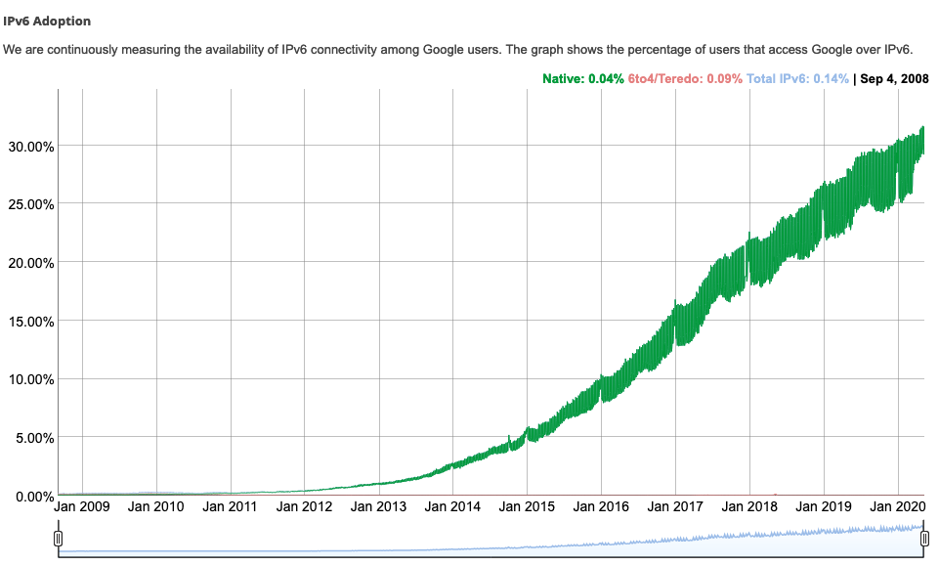
IPv6: adoption
Google¹: ~ 30% of clients access services via IPv6
NIST: 1/3 of all US government domains are IPv6 capable
¹ https://www.google.com/intl/en/ipv6/statistics.html

Slide 34
IPv6: adoption
Google¹: ~ 30% of clients access services via IPv6
NIST: 1/3 of all US government domains are IPv6 capable
Long (long!) time for deployment, use
  25 years and counting!
  think of application-level changes in last 25 years: WWW, social media, streaming media, gaming, telepresence, …
  Why?
¹ https://www.google.com/intl/en/ipv6/statistics.html

Slide 35
Network-layer functions
forwarding: move packets from router’s input to appropriate router output
data plane
routing: determine route taken by packets from source to destination
control plane
Two approaches to structuring network control plane:
per-router control (traditional)
logically centralized control (software defined networking)

Slide 36
Routing protocols
mobile network
Routing protocol goal: determine “good” paths (equivalently, routes), from sending hosts to receiving host, through network of routers
path: sequence of routers packets traverse from given initial source host to final destination host
“good”: least “cost”, “fastest”, “least congested”
routing: a “top-10” networking challenge!
national or global ISP
application
transport
network
link
physical
network
link
physical
network
link
physical
network
link
physical
network
link
physical
network
link
physical
datacenter
network
application
transport
network
link
physical
enterprise
network

Slide 37
Graph abstraction: link costs
5
c_{a,b}: cost of direct link connecting a and b
e.g., c_{w,z} = 5, c_{u,z} = ∞
  cost defined by network operator: could always be 1, or inversely related to bandwidth, or inversely related to congestion
v
3
w
2
5
u
2
1
z
3
1
2
x
y
1
graph: G = (N,E)
N: set of routers = { u, v, w, x, y, z }
E: set of links ={ (u,v), (u,x), (v,x), (v,w), (x,w), (x,y), (w,y), (w,z), (y,z) }

Slide 38
Routing algorithm classification
global: all routers have complete topology, link cost info
“link state” algorithms
dynamic: routes change more quickly
  periodic updates or in response to link cost changes
How fast do routes change?
static: routes change slowly over time
decentralized: iterative process of computation, exchange of info with neighbors
routers initially only know link costs to attached neighbors
“distance vector” algorithms
global or decentralized information?

Slide 39

Network layer: “control plane” roadmap
introduction
routing protocols
  link state
  distance vector
intra-ISP routing: OSPF
routing among ISPs: BGP
SDN control plane
Internet Control Message Protocol
network management, configuration
  SNMP
  NETCONF/YANG

Slide 40
Dijkstra’s link-state routing algorithm
centralized: network topology, link costs known to all nodes
  accomplished via “link state broadcast”
  all nodes have same info
computes least cost paths from one node (“source”) to all other nodes
  gives forwarding table for that node
iterative: after k iterations, know least cost path to k destinations
notation
c_{x,y}: direct link cost from node x to y; = ∞ if not direct neighbors
D(v): current estimate of cost of least-cost-path from source to destination v
p(v): predecessor node along path from source to v
N': set of nodes whose least-cost-path definitively known

Slide 41
Dijkstra’s link-state routing algorithm
1 Initialization:
2 N' = {u} /* compute least cost path from u to all other nodes */
3 for all nodes v
4 if v adjacent to u /* u initially knows direct-path-cost only to direct neighbors */
5 then D(v) = c_{u,v} /* but may not be minimum cost! */
6 else D(v) = ∞
7
8 Loop
9
10
11
12
13
14
15 until all nodes in N'
find w not in N' such that D(w) is a minimum
add w to N'
update D(v) for all v adjacent to w and not in N' :
D(v) = min ( D(v), D(w) + c_{w,v} )
/* new least-path-cost to v is either old least-cost-path to v or known
least-cost-path to w plus direct-cost from w to v */

Slide 42
Dijkstra’s algorithm: an example
v
w
x
y
z
Step
0
1
2
3
4
5
N'
D(v),p(v)
D(w),p(w)
D(x),p(x)
D(y),p(y)
D(z),p(z)
u
2,u
5,u
1,u
∞
∞
D(w),p(w)
5,u
4,x
3,y
3,y
5
Initialization (step 0):
For all a: if a adjacent to u then D(a) = c_{u,a}
v
3
w
2
5
u
2
1
z
3
1
2
x
y
1

Slide 43
Dijkstra’s algorithm: an example
v
w
x
y
z
Step
0
1
2
3
4
5
N'
D(v),p(v)
D(w),p(w)
D(x),p(x)
D(y),p(y)
D(z),p(z)
u
2,u
5,u
1,u
∞
∞
ux
D(w),p(w)
5,u
4,x
3,y
3,y
8 Loop
9
10
find a not in N' such that D(a) is a minimum
add a to N'
5
v
3
w
2
5
u
2
1
z
3
1
2
x
y
1

Slide 44

Dijkstra’s algorithm: an example
v
w
x
y
z
Step
0
1
2
3
4
5
N'
D(v),p(v)
D(w),p(w)
D(x),p(x)
D(y),p(y)
D(z),p(z)
u
2,u
5,u
1,u
∞
∞
ux
2,u
4,x
2,x
∞
D(w),p(w)
5,u
4,x
3,y
3,y
8 Loop
9
10
11
find a not in N' such that D(a) is a minimum
add a to N'
5
v
3
w
2
5
update D(b) for all b adjacent to a and not in N' :
D(b) = min ( D(b), D(a) + c_{a,b} )
u
2
1
z
3
1
2
D(v) = min ( D(v), D(x) + c_{x,v} ) = min(2, 1+2) = 2
x
y
1
D(w) = min ( D(w), D(x) + c_{x,w} ) = min (5, 1+3) = 4
D(y) = min ( D(y), D(x) + c_{x,y} ) = min(inf,1+1) = 2

Slide 45
Dijkstra’s algorithm: an example
v
w
x
y
z
Step
0
1
2
3
4
5
N'
D(v),p(v)
D(w),p(w)
D(x),p(x)
D(y),p(y)
D(z),p(z)
u
2,u
5,u
1,u
∞
∞
ux
2,u
4,x
2,x
∞
uxy
D(w),p(w)
5,u
4,x
3,y
3,y
8 Loop
9
10
find a not in N' such that D(a) is a minimum
add a to N'
5
v
3
w
2
5
u
2
1
z
3
1
2
x
y
1

Slide 46
Dijkstra’s algorithm: an example
v
w
x
y
z
Step
0
1
2
3
4
5
N'
D(v),p(v)
D(w),p(w)
D(x),p(x)
D(y),p(y)
D(z),p(z)
u
2,u
5,u
1,u
∞
∞
ux
2,u
4,x
2,x
∞
uxy
2,u
3,y
4,y
8 Loop
9
10
11
find a not in N' such that D(a) is a minimum
add a to N'
5
v
3
w
2
5
update D(b) for all b adjacent to a and not in N' :
D(b) = min ( D(b), D(a) + c_{a,b} )
u
2
1
z
3
1
2
D(w) = min ( D(w), D(y) + c_{y,w} ) = min (4, 2+1) = 3
x
y
1
D(z) = min ( D(z), D(y) + c_{y,z} ) = min(inf,2+2) = 4

Slide 47
Dijkstra’s algorithm: an example
v
w
x
y
z
Step
0
1
2
3
4
5
N'
D(v),p(v)
D(w),p(w)
D(x),p(x)
D(y),p(y)
D(z),p(z)
u
2,u
5,u
1,u
∞
∞
ux
2,u
4,x
2,x
∞
uxy
2,u
3,y
4,y
uxyv
8 Loop
9
10
find a not in N' such that D(a) is a minimum
add a to N'
5
v
3
w
2
5
u
2
1
z
3
1
2
x
y
1

Slide 48
Dijkstra’s algorithm: an example
v
w
x
y
z
Step
0
1
2
3
4
5
N'
D(v),p(v)
D(w),p(w)
D(x),p(x)
D(y),p(y)
D(z),p(z)
u
2,u
5,u
1,u
∞
∞
ux
2,u
4,x
2,x
∞
uxy
2,u
3,y
4,y
uxyv
3,y
4,y
8 Loop
9
10
11
find a not in N' such that D(a) is a minimum
add a to N'
5
v
3
w
2
5
update D(b) for all b adjacent to a and not in N' :
D(b) = min ( D(b), D(a) + c_{a,b} )
u
2
1
z
3
1
2
D(w) = min ( D(w), D(v) + c_{v,w} ) = min (3, 2+3) = 3
x
y
1

Slide 49
Dijkstra’s algorithm: an example
v
w
x
y
z
Step
0
1
2
3
4
5
N'
D(v),p(v)
D(w),p(w)
D(x),p(x)
D(y),p(y)
D(z),p(z)
u
2,u
5,u
1,u
∞
∞
ux
2,u
4,x
2,x
∞
uxy
2,u
3,y
4,y
uxyv
3,y
4,y
uxyvw
8 Loop
9
10
find a not in N' such that D(a) is a minimum
add a to N'
5
v
3
w
2
5
u
2
1
z
3
1
2
x
y
1

Slide 50
Dijkstra’s algorithm: an example
v
w
x
y
z
Step
0
1
2
3
4
5
N'
D(v),p(v)
D(w),p(w)
D(x),p(x)
D(y),p(y)
D(z),p(z)
u
2,u
5,u
1,u
∞
∞
ux
2,u
4,x
2,x
∞
uxy
2,u
3,y
4,y
uxyv
3,y
4,y
uxyvw
4,y
8 Loop
9
10
11
find a not in N' such that D(a) is a minimum
add a to N'
5
v
3
w
2
5
update D(b) for all b adjacent to a and not in N' :
D(b) = min ( D(b), D(a) + c_{a,b} )
u
2
1
z
3
1
2
D(z) = min ( D(z), D(w) + c_{w,z} ) = min (4, 3+5) = 4
x
y
1

Slide 51
Dijkstra’s algorithm: an example
v
w
x
y
z
Step
0
1
2
3
4
5
N'
D(v),p(v)
D(w),p(w)
D(x),p(x)
D(y),p(y)
D(z),p(z)
u
2,u
5,u
1,u
∞
∞
ux
2,u
4,x
2,x
∞
uxy
2,u
3,y
4,y
uxyv
3,y
4,y
uxyvw
4,y
uxyvwz
8 Loop
9
10
find a not in N' such that D(a) is a minimum
add a to N'
5
v
3
w
2
5
u
2
1
z
3
1
2
x
y
1

Slide 52
Dijkstra’s algorithm: an example
v
w
x
y
z
Step
0
1
2
3
4
5
N'
D(v),p(v)
D(w),p(w)
D(x),p(x)
D(y),p(y)
D(z),p(z)
u
2,u
5,u
1,u
∞
∞
ux
2,u
4,x
2,x
∞
uxy
2,u
3,y
4,y
uxyv
3,y
4,y
uxyvw
4,y
uxyvwz
8 Loop
9
10
11
find a not in N' such that D(a) is a minimum
add a to N'
5
v
3
w
2
5
update D(b) for all b adjacent to a and not in N' :
D(b) = min ( D(b), D(a) + c_{a,b} )
u
2
1
z
3
1
2
x
y
1

Slide 53
Dijkstra’s algorithm: an example
v
w
x
y
z
Step
0
1
2
3
4
5
N'
D(v),p(v)
D(w),p(w)
D(x),p(x)
D(y),p(y)
D(z),p(z)
u
2,u
5,u
1,u
∞
∞
ux
2,u
4,x
2,x
∞
uxy
2,u
3,y
4,y
uxyv
3,y
4,y
D(w),p(w)
5,u
4,x
3,y
3,y
uxyvw
4,y
uxyvwz
Initialization (step 0): For all a: if a adjacent to then D(a) = c_{u,a}
5
find a not in N' such that D(a) is a minimum
add a to N'
update D(b) for all b adjacent to a and not in N' :
D(b) = min ( D(b), D(a) + c_{a,b} )
v
3
w
2
5
u
2
1
z
3
1
2
x
y
1

Slide 54
Dijkstra’s algorithm: an example
5
v
3
w
2
5
u
2
1
z
3
1
2
D(w),p(w)
5,u
4,x
3,y
3,y
x
y
1
resulting least-cost-path tree from u:
resulting forwarding table in u:
v
w
destination
outgoing link
v
x
y
w
x
(u,v)
(u,x)
(u,x)
(u,x)
(u,x)
route from u to v directly
u
z
x
route from u to all other destinations via x
y

Slide 55
Dijkstra’s algorithm: another example
v
w
x
y
z
x
D(v),
p(v)
D(w),
p(w)
D(x),
p(x)
D(y),
p(y)
D(z),
p(z)
9
Step
N'
0
u
7,u
3,u
5,u
∞
∞
5
7
4
1
uw
6,w
5,u
11,w
∞
8
2
uwx
6,w
11,w
14,x
u
3
w
y
z
2
3
uwxv
10,v
14,x
3
4
uwxvy
12,y
7
4
5
uwxvyz
v
notes:
construct least-cost-path tree by tracing predecessor nodes
ties can exist (can be broken arbitrarily)

Slide 56
Distance vector algorithm
Dynamic Routing Algorithm.
Find least cost from Source to Destination.
Based on Bellman-Ford (BF) equation (dynamic programming):
  One Routing Table is Created per Node
Bellman-Ford equation
Defines distance at each node.
Let D_{x}(y): cost of least-cost path from x to y.
Then:
D_{x}(y) = min_{v} { c_{x,v} + D_{v}(y) }
Source Destination
v’s estimated least-cost-path cost to y
direct cost of link from x to v
min taken over all neighbors v of x

Slide 57
Bellman-Ford Example
Suppose that u’s neighboring nodes, x,v,w, know that for destination z:
D_{v}(z) = 5
D_{w}(z) = 3
Bellman-Ford equation says:
5
D_{u}(z) = min { c_{u,v} + D_{v}(z),
c_{u,x} + D_{x}(z),
c_{u,w} + D_{w}(z) }
v
3
w
2
5
u
2
1
z
3
= min {2 + 5,
1 + 3,
5 + 3} = 4
1
2
x
y
1
D_{x}(z) = 3
node achieving minimum (x) is next hop on estimated least-cost path to destination (z)
D_{u}(Z) = min_{p} { c_{u,p} + D_{p}(y) }

Slide 58
Distance vector algorithm
key idea:
from time-to-time, each node sends its own distance vector estimate to neighbors
when x receives new DV estimate from any neighbor, it updates its own DV using B-F equation:
D_{x}(y) ← min_{v}{c_{x,v} + D_{v}(y)} for each node y ∊ N
under minor, natural conditions, the estimate D_{x}(y) converge to the actual least cost d_{x}(y)

Slide 59
Distance vector algorithm:
each node:
iterative, asynchronous: each local iteration caused by:
local link cost change
DV update message from neighbor
wait for (change in local link cost or msg from neighbor)
recompute DV estimates using DV received from neighbor
distributed, self-stopping: each node notifies neighbors only when its DV changes
  neighbors then notify their neighbors – only if necessary
  no notification received, no actions taken!
if DV to any destination has changed, notify neighbors

Slide 60
Distance vector: example
DV in a: D_{a}(a)=0
D_{a}(b) = 8
D_{a}(c) = ∞
D_{a}(d) = 1
D_{a}(e) = ∞
D_{a}(f) = ∞
D_{a}(g) = ∞
D_{a}(h) = ∞
D_{a}(i) = ∞
a
b
c
8
1
t=0
1
1
All nodes have distance estimates to nearest neighbors (only)
A few asymmetries:
missing link
larger cost
d
e
f
1
1
All nodes send their local distance vector to their neighbors
1
1
1
g
h
i
1
1

Slide 61
Distance vector example: iteration
a
b
c
8
1
t=1
1
1
All nodes:
receive distance vectors from neighbors
compute their new local distance vector
send their new local distance vector to neighbors
d
e
f
1
1
1
1
1
g
h
i
1
1

Slide 62
Distance vector example: iteration
a
compute
compute
compute
b
c
8
1
t=1
1
1
All nodes:
receive distance vectors from neighbors
compute their new local distance vector
send their new local distance vector to neighbors
d
compute
e
f
compute
compute
1
1
1
1
1
g
h
i
compute
compute
1
compute
1

Slide 63
Distance vector example: iteration
a
b
c
8
1
t=1
1
1
All nodes:
receive distance vectors from neighbors
compute their new local distance vector
send their new local distance vector to neighbors
d
e
f
1
1
1
1
1
g
h
i
1
1

Slide 64
Distance vector example: iteration
a
b
c
8
1
t=2
1
1
All nodes:
receive distance vectors from neighbors
compute their new local distance vector
send their new local distance vector to neighbors
d
e
f
1
1
1
1
1
g
h
i
1
1

Slide 65
Distance vector example: iteration
compute
compute
compute
a
b
c
2
1
t=2
1
1
All nodes:
receive distance vectors from neighbors
compute their new local distance vector
send their new local distance vector to neighbors
d
compute
compute
compute
e
f
1
1
1
1
1
g
compute
compute
compute
h
i
8
1

Slide 66
Distance vector example: iteration
a
b
c
8
1
t=2
1
1
All nodes:
receive distance vectors from neighbors
compute their new local distance vector
send their new local distance vector to neighbors
d
e
f
1
1
1
1
1
g
h
i
1
1

Slide 67
Distance vector example: iteration
…. and so on
Let’s next take a look at the iterative computations at nodes

Slide 68
Distance vector example: computation
DV in b:
DV in c:
  D_{c}(a) = ∞
  D_{c}(b) = 1
  D_{c}(c) = 0
  D_{c}(d) = ∞
  D_{c}(e) = ∞
  D_{c}(f) = ∞
  D_{c}(g) = ∞
  D_{c}(h) = ∞
D_{c}(i) = ∞
  D_{b}(a) = 8
  D_{b}(c) = 1
  D_{b}(d) = ∞
  D_{b}(e) = 1
D_{b}(f) = ∞
D_{b}(g) = ∞
D_{b}(h) = ∞
D_{b}(i) = ∞
DV in a: D_{a}(a)=0
D_{a}(b) = 8
D_{a}(c) = ∞
D_{a}(d) = 1
D_{a}(e) = ∞
D_{a}(f) = ∞
D_{a}(g) = ∞
D_{a}(h) = ∞
D_{a}(i) = ∞
a
b
c
8
1
t=1
1
1
b receives DVs from a, c, e
DV in e:
  D_{e}(a) = ∞
  D_{e}(b) = 1
  D_{e}(c) = ∞
  D_{e}(d) = 1
  D_{e}(e) = 0
  D_{e}(f) = 1
  D_{e}(g) = ∞
  D_{e}(h) = 1
D_{e}(i) = ∞
d
e
f
1
1
1
1
1
g
h
i
1
1

Slide 69
Distance vector example: computation
DV in b:
DV in c:
  D_{c}(a) = ∞
  D_{c}(b) = 1
  D_{c}(c) = 0
  D_{c}(d) = ∞
  D_{c}(e) = ∞
  D_{c}(f) = ∞
  D_{c}(g) = ∞
  D_{c}(h) = ∞
D_{c}(i) = ∞
  D_{b}(a) = 8
  D_{b}(c) = 1
  D_{b}(d) = ∞
  D_{b}(e) = 1
D_{b}(f) = ∞
D_{b}(g) = ∞
D_{b}(h) = ∞
D_{b}(i) = ∞
DV in a: D_{a}(a)=0
D_{a}(b) = 8
D_{a}(c) = ∞
D_{a}(d) = 1
D_{a}(e) = ∞
D_{a}(f) = ∞
D_{a}(g) = ∞
D_{a}(h) = ∞
D_{a}(i) = ∞
a
b
c
b
8
compute
1
t=1
1
1
b receives DVs from a, c, e, computes:
DV in e:
  D_{e}(a) = ∞
  D_{e}(b) = 1
  D_{e}(c) = ∞
  D_{e}(d) = 1
  D_{e}(e) = 0
  D_{e}(f) = 1
  D_{e}(g) = ∞
  D_{e}(h) = 1
D_{e}(i) = ∞
e
d
e
f
1
1
D_{b}(a) = min{c_{b,a}+D_{a}(a), c_{b,c} +D_{c}(a), c_{b,e}+D_{e}(a)} = min{8,∞,∞} = 8
D_{b}(c) = min{c_{b,a}+D_{a}(c), c_{b,c} +D_{c}(c), c _{b,e} +D_{e}(c)} = min{∞,1,∞} = 1
D_{b}(d) = min{c_{b,a}+D_{a}(d), c_{b,c} +D_{c}(d), c _{b,e} +D_{e}(d)} = min{9,2,∞} = 2
1
1
1
D_{b}(e) = min{c_{b,a}+D_{a}(e), c_{b,c} +D_{c}(e), c _{b,e} +D_{e}(e)} = min{∞,∞,1} = 1
DV in b:
D_{b}(f) = min{c_{b,a}+D_{a}(f), c_{b,c} +D_{c}(f), c _{b,e} +D_{e}(f)} = min{∞,∞,2} = 2
D_{b}(g) = min{c_{b,a}+D_{a}(g), c_{b,c} +D_{c}(g), c _{b,e}+D_{e}(g)} = min{∞, ∞, ∞} = ∞
  D_{b}(a) = 8
  D_{b}(c) = 1
  D_{b}(d) = 2
  D_{b}(e) = 1
D_{b}(f) =2
D_{b}(g) = ∞
D_{b}(h) = 2
D_{b}(i) = ∞
g
h
1
i
1
D_{b}(h) = min{c_{b,a}+D_{a}(h), c_{b,c} +D_{c}(h), c _{b,e}+D_{e}(h)} = min{∞, ∞, 2} = 2
D_{b}(i) = min{c_{b,a}+D_{a}(i), c_{b,c} +D_{c}(i), c _{b,e}+D_{e}(i)} = min{∞, ∞, ∞} = ∞

Slide 70
Distance vector example: computation
DV in b:
DV in c:
  D_{c}(a) = ∞
  D_{c}(b) = 1
  D_{c}(c) = 0
  D_{c}(d) = ∞
  D_{c}(e) = ∞
  D_{c}(f) = ∞
  D_{c}(g) = ∞
  D_{c}(h) = ∞
D_{c}(i) = ∞
  D_{b}(a) = 8
  D_{b}(c) = 1
  D_{b}(d) = ∞
  D_{b}(e) = 1
D_{b}(f) = ∞
D_{b}(g) = ∞
D_{b}(h) = ∞
D_{b}(i) = ∞
DV in a: D_{a}(a)=0
D_{a}(b) = 8
D_{a}(c) = ∞
D_{a}(d) = 1
D_{a}(e) = ∞
D_{a}(f) = ∞
D_{a}(g) = ∞
D_{a}(h) = ∞
D_{a}(i) = ∞
a
b
c
8
1
t=1
1
1
c receives DVs from b
DV in e:
  D_{e}(a) = ∞
  D_{e}(b) = 1
  D_{e}(c) = ∞
  D_{e}(d) = 1
  D_{e}(e) = 0
  D_{e}(f) = 1
  D_{e}(g) = ∞
  D_{e}(h) = 1
D_{e}(i) = ∞
d
e
f
1
1
1
1
1
g
h
i
1
1

Slide 71
Distance vector example: computation
DV in b:
DV in c:
  D_{c}(a) = ∞
  D_{c}(b) = 1
  D_{c}(c) = 0
  D_{c}(d) = ∞
  D_{c}(e) = ∞
  D_{c}(f) = ∞
  D_{c}(g) = ∞
  D_{c}(h) = ∞
D_{c}(i) = ∞
  D_{b}(a) = 8
  D_{b}(c) = 1
  D_{b}(d) = ∞
  D_{b}(e) = 1
D_{b}(f) = ∞
D_{b}(g) = ∞
D_{b}(h) = ∞
D_{b}(i) = ∞
a
b
c
1
compute
8
t=1
1
1
c receives DVs from b computes:
d
e
f
D_{c}(a) = min{c_{c,b}+D_{b}(a}} = 1 + 8 = 9
DV in c:
  D_{c}(a) = 9
  D_{c}(b) = 1
  D_{c}(c) = 0
  D_{c}(d) = 2
  D_{c}(e) = ∞
  D_{c}(f) = ∞
  D_{c}(g) = ∞
  D_{c}(h) = ∞
D_{c}(i) = ∞
D_{c}(b) = min{c_{c,b}+D_{b}(b)} = 1 + 0 = 1
D_{c}(d) = min{c_{c,b}+D_{b}(d)} = 1+ ∞ = ∞
D_{c}(e) = min{c_{c,b}+D_{b}(e)} = 1 + 1 = 2
D_{c}(f) = min{c_{c,b}+D_{b}(f)} = 1+ ∞ = ∞
D_{c}(g) = min{c_{c,b}+D_{b}(g)} = 1+ ∞ = ∞
* Check out the online interactive exercises for more examples: http://gaia.cs.umass.edu/kurose_ross/interactive/
g
h
i
D_{c}(h) = min{c_{bc,b}+D_{b}(h)} = 1+ ∞ = ∞
D_{c}(i) = min{c_{c,b}+D_{b}(i)} = 1+ ∞ = ∞

Slide 72
Distance vector example: computation
DV in b:
  D_{b}(a) = 8
  D_{b}(c) = 1
  D_{b}(d) = ∞
  D_{b}(e) = 1
D_{b}(f) = ∞
D_{b}(g) = ∞
D_{b}(h) = ∞
D_{b}(i) = ∞
DV in e:
  D_{e}(a) = ∞
  D_{e}(b) = 1
  D_{e}(c) = ∞
  D_{e}(d) = 1
  D_{e}(e) = 0
  D_{e}(f) = 1
  D_{e}(g) = ∞
  D_{e}(h) = 1
D_{e}(i) = ∞
DV in d:
  D_{c}(a) = 1
  D_{c}(b) = ∞
  D_{c}(c) = ∞
  D_{c}(d) = 0
  D_{c}(e) = 1
  D_{c}(f) = ∞ D_{c}(g) = 1
  D_{c}(h) = ∞
D_{c}(i) = ∞
a
b
c
8
1
t=1
Q: what is new DV computed in e at t=1?
1
1
e receives DVs from b, d, f, h
d
compute
f
DV in f:
  D_{c}(a) = ∞
  D_{c}(b) = ∞
  D_{c}(c) = ∞
  D_{c}(d) = ∞
  D_{c}(e) = 1
  D_{c}(f) = 0
  D_{c}(g) = ∞
  D_{c}(h) = ∞
D_{c}(i) = 1
e
DV in h:
  D_{c}(a) = ∞
  D_{c}(b) = ∞
  D_{c}(c) = ∞
  D_{c}(d) = ∞
  D_{c}(e) = 1
  D_{c}(f) = ∞
  D_{c}(g) = 1
  D_{c}(h) = 0
D_{c}(i) = 1
1
1
1
1
1
g
h
i
1
1

Slide 73
Comparison of LS and DV algorithms
message complexity
  LS: n routers, O(n²) messages sent
  DV: exchange between neighbors; convergence time varies
robustness: what happens if router malfunctions, or is compromised?
LS:
  router can advertise incorrect link cost
  each router computes only its own table
DV:
  DV router can advertise incorrect path cost (“I have a really low cost path to everywhere”): black-holing
  each router’s table used by others: error propagate thru network
speed of convergence
LS: O(n²) algorithm, O(n²) messages
  may have oscillations
DV: convergence time varies
  may have routing loops
  count-to-infinity problem

Slide 74
Making routing scalable
our routing study thus far - idealized
all routers identical
network “flat”
… not true in practice
scale: billions of destinations:
can’t store all destinations in routing tables!
routing table exchange would swamp links!
administrative autonomy:
Internet: a network of networks
each network admin may want to control routing in its own network

Slide 75
Internet approach to scalable routing
aggregate routers into regions known as “autonomous systems” (AS) (a.k.a. “domains”)
intra-AS (aka “intra-domain”): routing among within same AS (“network”)
all routers in AS must run same intra-domain protocol
routers in different AS can run different intra-domain routing protocols
gateway router: at “edge” of its own AS, has link(s) to router(s) in other AS’es
inter-AS (aka “inter-domain”): routing among AS’es
gateways perform inter-domain routing (as well as intra-domain routing)

Slide 76
Interconnected ASes
forwarding table configured by intra- and inter-AS routing algorithms
Intra-AS
Routing
Inter-AS
Routing
  intra-AS routing determine entries for destinations within AS
forwarding
table
  inter-AS & intra-AS determine entries for external destinations
intra-AS
routing
3c
3a
inter-AS routing
2c
3b
2a
intra-AS
routing
1c
2b
AS3
intra-AS
routing
1a
1b
AS2
1d
AS1

Slide 77

Inter-AS routing: a role in intradomain forwarding
suppose router in AS1 receives datagram destined outside of AS1:
AS1 inter-domain routing must:
learn which destinations reachable through AS2, which through AS3
propagate this reachability info to all routers in AS1
  router should forward packet to gateway router in AS1, but which one?
3c
3a
2c
other
networks
3b
2a
1c
2b
AS3
other
networks
1a
1b
AS2
1d
AS1

Slide 78
Inter-AS routing: routing within an AS
most common intra-AS routing protocols:
RIP: Routing Information Protocol [RFC 1723]
  classic DV: DVs exchanged every 30 secs
  no longer widely used
EIGRP: Enhanced Interior Gateway Routing Protocol
  DV based
  formerly Cisco-proprietary for decades (became open in 2013 [RFC 7868])
OSPF: Open Shortest Path First [RFC 2328]
  link-state routing
  IS-IS protocol (ISO standard, not RFC standard) essentially same as OSPF

